Slide 1

SATKHIRA AGRO
Arif Isteak Pavel
Batch:40
Roll:01-020-08
Date:07.12.2024

Slide 2
Introduction
Satkhira Agro Farm is a prominent agricultural enterprise located in Satkhira Khulna Bangladesh. Specializing in the cultivation of essential crops such as rice, potatoes, wheat, vegetables, and fruits, the farm plays a crucial role in meeting the local demand for these staples. By ensuring a steady supply of high-quality produce, Satkhira Agro Farm not only supports the dietary needs of the local population but also contributes significantly to the economic stability and growth of the region.
The farm’s operations are designed to maximize productivity while adhering to sustainable farming practices. This approach not only enhances the farm’s output but also ensures the long term health of the soil and surrounding environment.
Through its commitment to quality and sustainability, Satkhira Agro Farm has established itself as a key player in the local agricultural sector, fostering food security and economic resilience in Satkhira and beyond

Slide 3
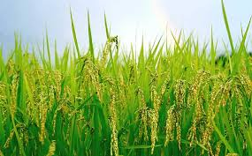


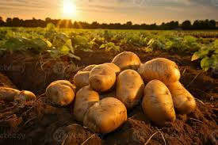
Major Products of Agro
Rice
wheat
Tomato
Potato

Slide 4
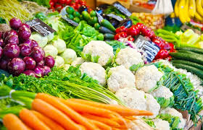
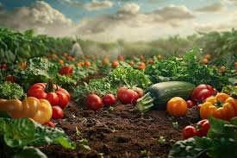
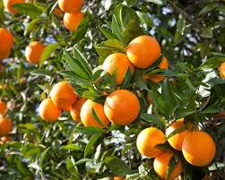

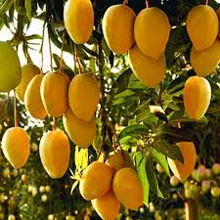
Vegetables
Seasonal Production
Fruits
Orange
Banana
Mango

Slide 5
Service to customer
High-Quality Produce
Customer-Centric Approach
Educational Outreach
Sustainability and Environmental Responsibility
Customer Support :Responsive Service: The farm’s customer service team is always ready to assist with inquiries, orders, and any issues that may arise. Feedback and Improvement: Customer feedback is highly valued and used to continuously improve the quality of products and services. Satkhira Agro Farm is committed to delivering the best possible experience to its customers, ensuring they receive fresh, high-quality produce while supporting sustainable and environmentally friendly practices

Slide 6
We can create a pie chart to show the distribution of different crops produced by SATKHIRA Agro Farm:
Crop Product | Total Land
Rice | 20%
Wheat | 10%
Potatoes | 25%
Tomatoes | 15%
Vegetable | 25%
Fruits | 15%

Slide 7
My Agro Farm’s business plan
Production Plan
Wheat Production
Fruit Production
Potato Production
Rice Production
Financial Projections
Revenue Streams
Cost Management
Creation Job
Economic Impact
Market Stability

Slide 8
Crops Production TabLE & Chart
Crop product | 2020-21(MT) | 2022-23(MT) | 2023-24(MT)
RICE | 2300 | 3300 | 2300
WHEAT | 3400 | 4500 | 6500
POTATOS | 4500 | 2300 | 4590
TOMATOS | 4300 | 4500 | 4560
FRUITS | 4500 | 2100 | 4360

Slide 9
Conclusion SATKHIRA AGRO Farm significantly contributes to the local economy and food security in SATKHIRA, Bangladesh, by producing a variety of essential crops. Here's a detailed look at its contributions As staple foods in Bangladesh, the production of rice and wheat by SATKHIRA Agro Farm helps to meet the daily dietary needs of the local population. This reduces dependency on imports and stabilizes local food prices. These are crucial for a balanced diet, providing essential nutrients. The farm's production ensures a steady supply of fresh produce, enhancing the nutritional intake of the community. By growing a variety of fruits, the farm adds diversity to the local diet and supports overall health and well-being.The farm provides employment opportunities for local residents, contributing to the reduction of unemployment and boosting the local economy. By supplying local markets with a consistent flow of agricultural products, the farm helps stabilize prices and ensures that local businesses have reliable access to fresh.

Slide 10
Similar Agro Farm
Farming Future Bangladesh (FFB)
Amir Agro Farm
Organic Farming
Farmshelf
Babylon Micro-Farms Inc
Clean Crop Technologies
Tortuga AgTech

Slide 11




Contact Information
arifisteak.pavel@gmail.com
Sarkhira Agro
+8801750897873
Satkhira, Bangladesh

Slide 12


